Slide 1
Crop Recommendation in India
Use of Explainable AI using LIME on Crop Recommendation in India Student Name: Ajay Parmar Roll No: 24CSM1R04 Guide Name: Mrs. Manjubala Bisi

Slide 2

Objectives of the Project
Key Objectives
Integrate Explainable AI using LIME for better crop recommendations. Enhance decision-making capabilities for farmers. Our project aims to empower farmers with clear, actionable insights!

Slide 3

Literature Survey Overview
Previous Works
Reviewed literature on Explainable AI and its applications in agriculture. Identified gaps in existing crop recommendation systems regarding interpretability. Setting the context for our project through comprehensive literature review!
Shams, M.Y., Gamel, S.A., Talaat, F.M. (2024). Enhancing Crop Recommendation Systems with XAI. Neural Comput & Applications. https://doi.org/10.1007/s00521-023-09391-2
Nature Research (2025). Cloud-Based Crop Recommendation Model. Sci. Rep. https://doi.org/10.1038/s41598-025-93417-3

Slide 4
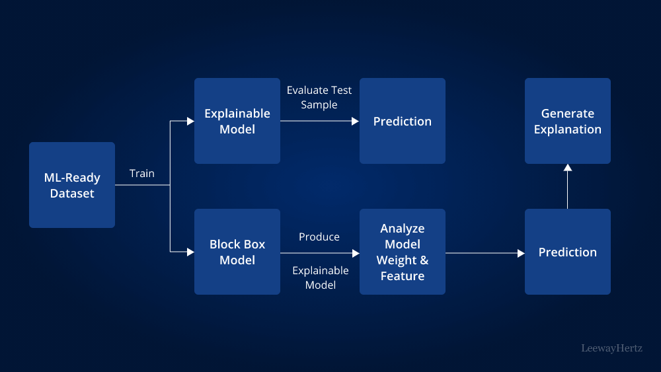
Introduction to Explainable AI
Explainable AI (XAI) is a crucial aspect of modern artificial intelligence, focusing on making AI systems understandable to humans.
Significance: Ensures transparency and trust in AI applications.
Relevance in Agriculture: Helps farmers make informed decisions based on AI recommendations.
Understanding AI's decisions is vital for its acceptance in agriculture!

Slide 5
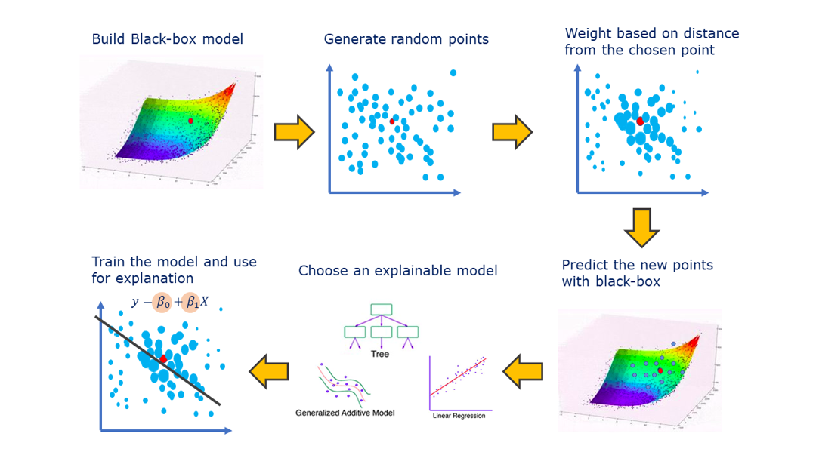
Importance of LIME in AI
What is LIME?:
LIME stands for Local Interpretable Model-agnostic Explanations.
It provides insights into individual predictions made by AI models.
Advantages for Crop Recommendation Systems: Enhances model interpretability.
Empowers farmers to understand why certain crops are recommended.
LIME bridges the gap between complex AI models and user comprehension!

Slide 6

Crop Recommendation in India
Critical Need:
India faces diverse agricultural challenges, including climate variability and soil conditions.
Effective crop recommendation systems can significantly enhance productivity.
Challenges Faced by Farmers: Lack of tailored advice leads to poor crop choices.
Farmers often lack trust in AI-driven recommendations.
Addressing these challenges is essential for agricultural advancement!

Slide 7
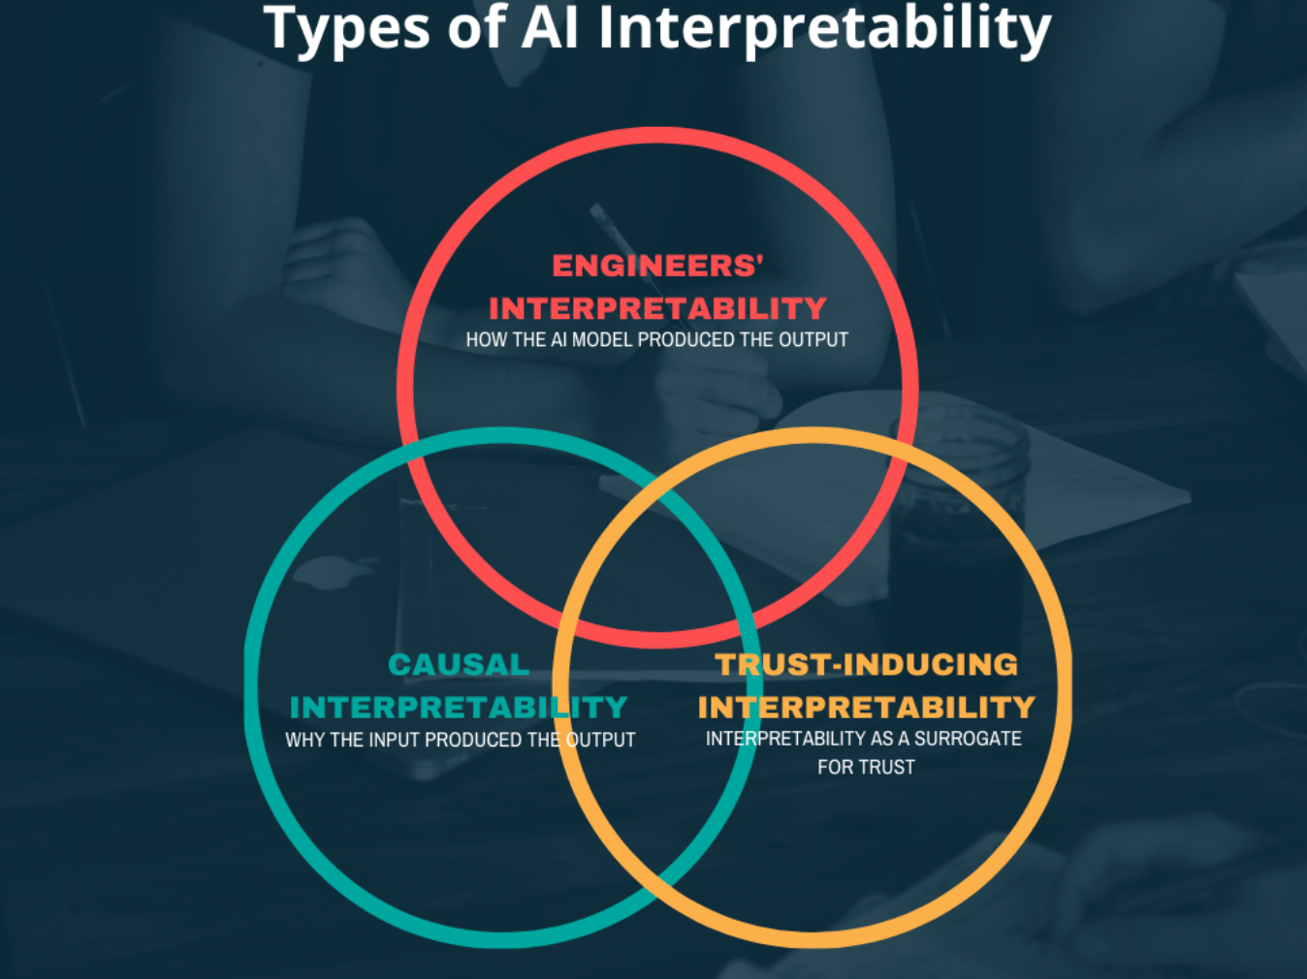
Problem Statement
Defining the Problems:
Lack of Interpretability: Many AI models are black boxes, making it hard for users to trust their outputs.
Consequences on Agricultural Decisions: Poor understanding can lead to suboptimal crop choices and reduced productivity.

Slide 8
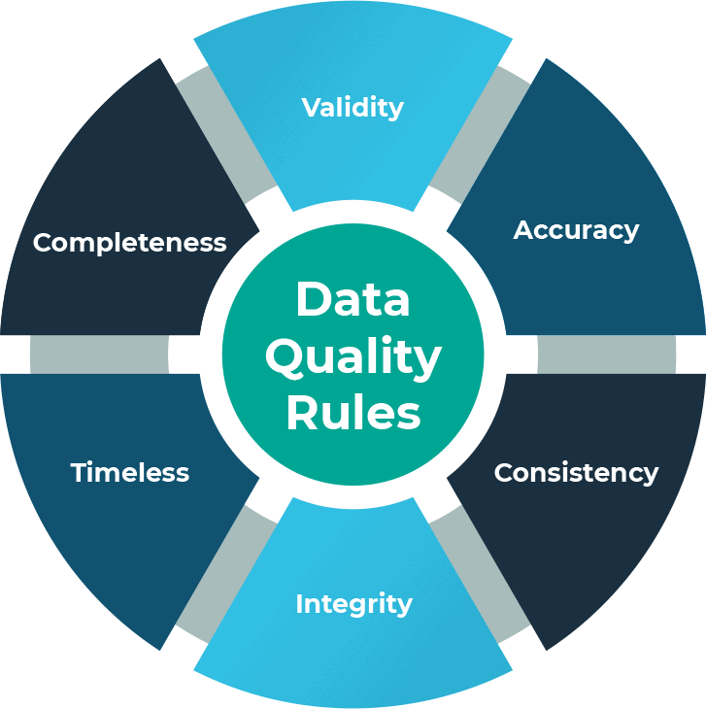
Challenges in Crop Recommendation Systems
Existing Challenges:
Data Quality: Inconsistent and incomplete data hampers model effectiveness.
Model Transparency: Farmers struggle to trust opaque AI models.
User Trust: Building trust in AI decisions is crucial for adoption.

Slide 9

Key Findings from Literature
Informing Methodology:
Lack of user-friendly explanations in current models.
Need for models that not only predict but also explain decisions.

Slide 10
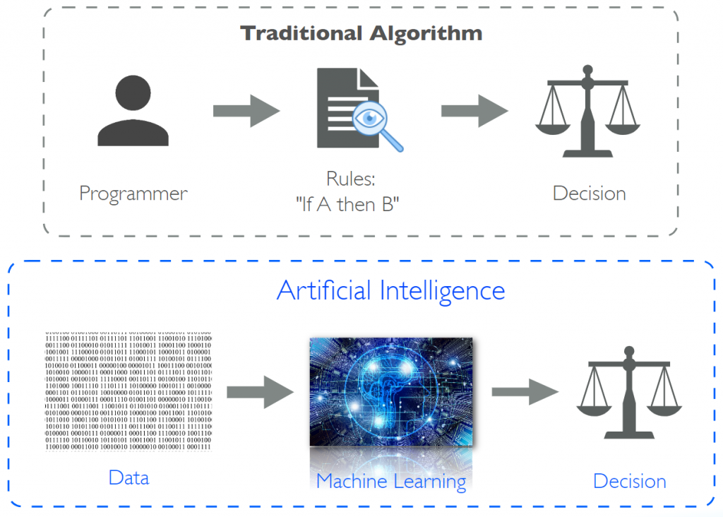
Contributions of Previous Works
Significant Contributions:
Previous studies laid the groundwork for integrating explainability in AI.
Highlighted the importance of user engagement in agricultural AI applications.

Slide 11

Proposed Solution Outline
High-Level Overview:
Utilize LIME to enhance crop recommendation systems.
Focus on creating interpretable models that provide clear explanations for recommendations.

Slide 12
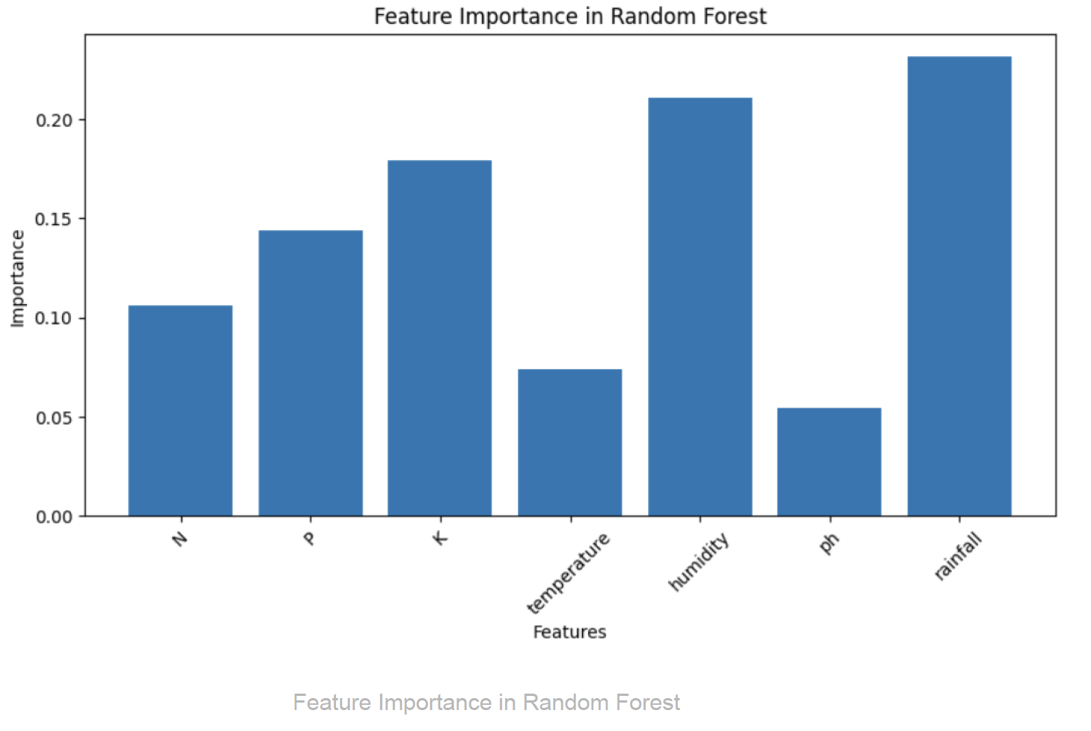
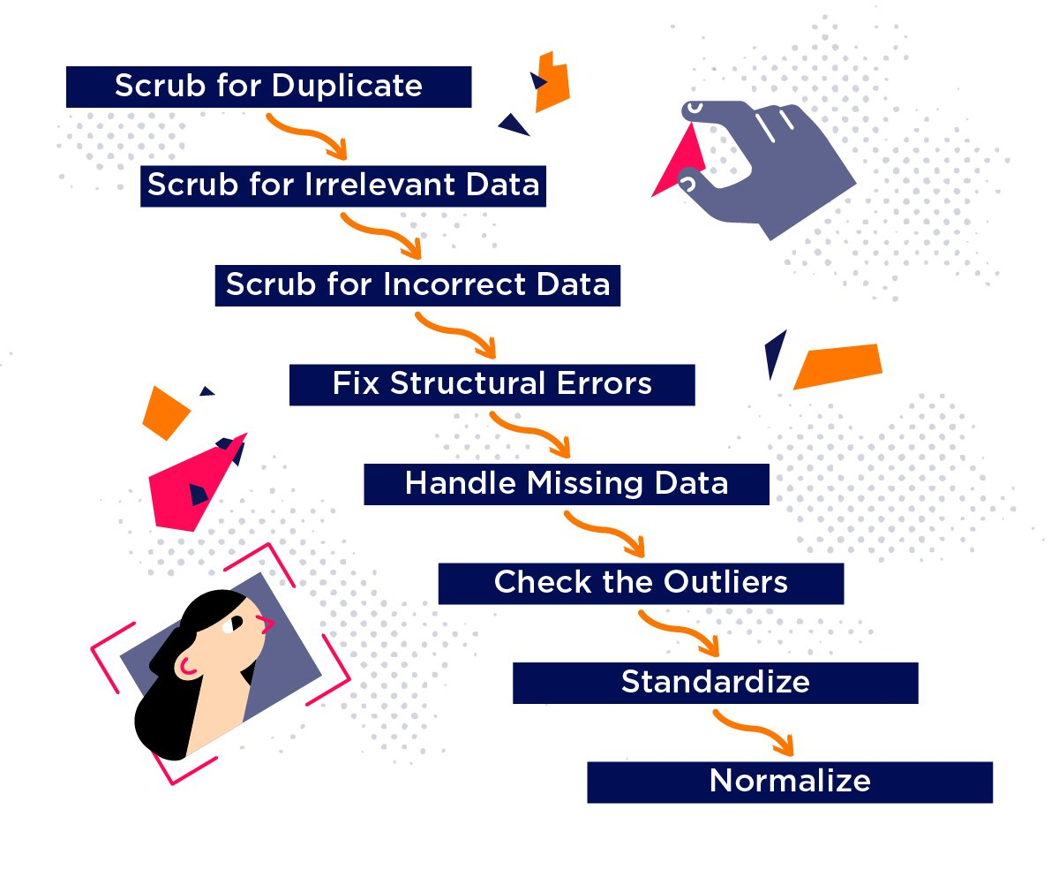
Data Collection and Preparation
Data Collection Methods
- Gathered agricultural data from government databases and local surveys.
- Ensured a diverse dataset covering various crops and regions.
Preparation Steps
- Data cleaning and preprocessing to ensure quality.
- Standardization of data formats for analysis.
Quality data is the foundation of effective AI models!

Slide 13
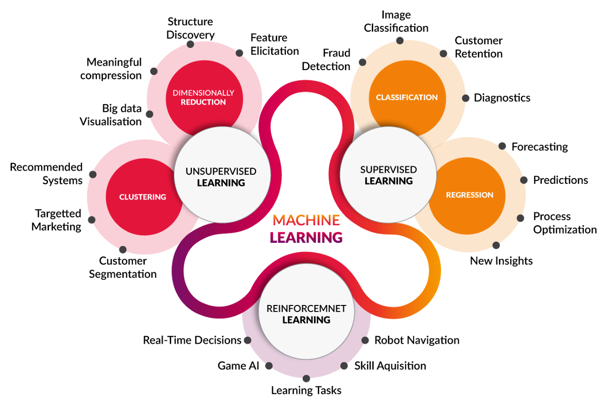
Model Selection and Justification
Selected Models:
Chose machine learning models known for their performance and interpretability, such as Decision Trees and Random Forests.
Selected models balance accuracy with the ability to provide clear insights into decision-making.

Slide 14

LIME Application Process
Applying LIME:
LIME generates explanations for individual predictions by approximating the model locally.
Provides insights into the most influential features for crop recommendations.
This process enhances transparency and user understanding!

Slide 15
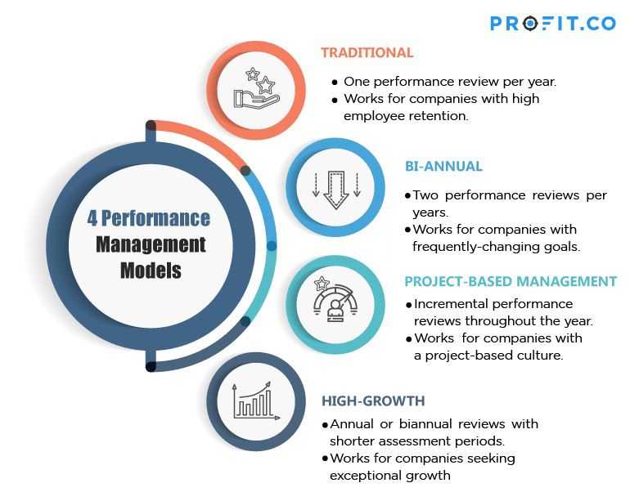
Evaluation Metrics
Assessing Performance:
Accuracy: Overall classification accuracy measured on the test set using accuracy_score.
Feature Importance: Ranked based on contribution to predictions (Random Forest feature importances).
Interpretability: Explained with LIME, highlighting key feature contributions per prediction.
Confidence Analysis: LIME outputs used to assess prediction certainty and alternate crop options.

Slide 16
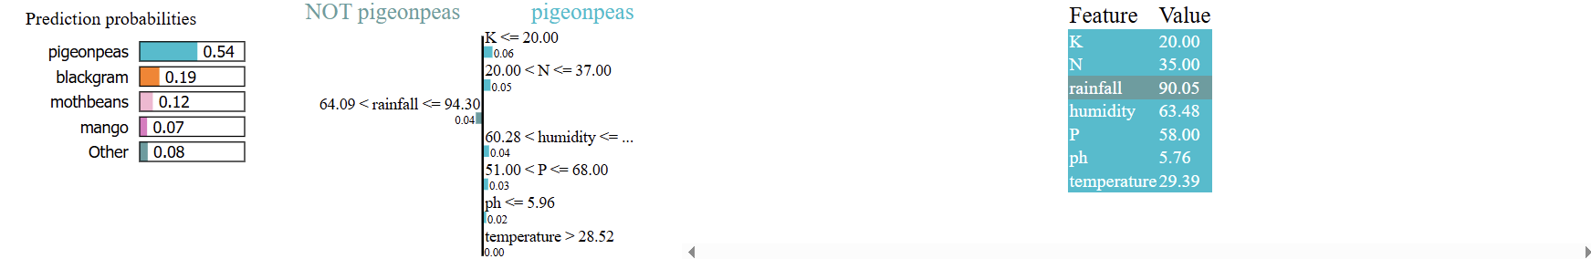
Results Overview
Summary of Results:
Achieved accuracy of 94% using Random Forest on test data.
LIME effectively explained key features influencing each crop prediction.
Users gained clear insights into crop selection based on soil nutrients, rainfall, and humidity.
Demonstrated strong potential of Explainable AI in decision support for Indian agriculture.

Slide 17
Performance Comparison
Traditional vs. LIME-Enhanced Models:
Accuracy: Random Forest model achieved 94% test accuracy.
Interpretability: LIME provided instance-level feature explanations, absent in traditional models.
User Insights: LIME highlighted key features (e.g., nitrogen, potassium, rainfall), improving user trust.
Conclusion: LIME-enhanced system delivered both high accuracy and transparency, outperforming black-box models in usability.

Slide 18

Case Studies
Practical Implications:
Specific case studies where the proposed model was applied in real-world scenarios.
Demonstrated ease of understanding and practical benefits for farmers.
Real-world applications validate our approach and its effectiveness!

Slide 19

Conclusion
Synthesizing Findings:
Emphasized the importance of Explainable AI and LIME in crop recommendation systems.
Highlighted the positive impact on agricultural decision-making in India.
Our project paves the way for more transparent and effective AI in agriculture!

Slide 20

Future Work Recommendations
Potential Directions:
Explore further enhancements in Explainable AI for agriculture.
Suggest refinements to the model based on user feedback and evolving agricultural needs.
The journey of improving AI in agriculture continues!

Slide 21
References
Academic References
List of all academic references and sources cited throughout the presentation. Provides credibility and allows for further reading on the topic. Thank you for your attention! Let's advance agricultural practices together!
—-------------------------------------------------------------------------------------------
Shams, M.Y., Gamel, S.A., Talaat, F.M. (2024). Enhancing Crop Recommendation Systems with XAI. Neural Comput & Applications. https://doi.org/10.1007/s00521-023-09391-2
Turgut, Ö., Kök, İ., Özdemir, S. (2024). AgroXAI: Explainable AI Crop Recommendation.
Akkem, Y., Biswas, S.K., Varanasi, A. (2025). Role of XAI in Crop Recommendation. IJISA, 17(1), 23–32.
Nature Research (2025). Cloud-Based Crop Recommendation Model. Sci. Rep. https://doi.org/10.1038/s41598-025-93417-3
Divya, S., Lavanya, S. (2025). Crop Recommendation Using Explainable AI. IJRPR, 6(3), 65–70.

